Slide 1
Eclipse Installation Hello World JAVA Program
Lab -0

Slide 2
Install Eclipse with this link
https://www.eclipse.org/downloads/packages/installer ( Windows)
Eclipse is an integrated development environment (IDE) for Java and other programming languages like C, C++, PHP, and Ruby etc. Development environment provided by Eclipse includes the Eclipse Java development tools (JDT) for Java, Eclipse CDT for C/C++, and Eclipse PDT for PHP, among others.

Slide 3
Java Data types
int myNum = 5; // Integer (whole number)
float myFloatNum = 5.99f; // Floating point number
char myLetter = 'D'; // Character
boolean myBool = true; // Boolean
String myText = "Hello"; // String

Slide 4
Simple Hello World
You can use the link provided in the last slide to create a project in eclipse for java console application.
Things to note
Have as practice creating a package . And then a driver class ( with public static void main()) within that.
In java everything is inside a class. Even main() also is inside a class.
In java name of the driver class and file name of the driver will be the same.
For today write the remaining programs in the main()
( In java driver program

Slide 5
To create a hello world Java program follow the steps
https://mail.codejava.net/ides/eclipse/how-to-create-build-and-run-a-java-hello-world-program-with-eclipse

Slide 6
Output on screen
int j=3;
System.out.print(“Hello World”);
System.out.print(j+" ");
System.out.println(num1 + " and " + num2 + " is:");

Slide 7
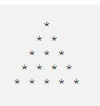
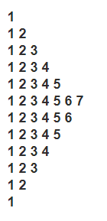
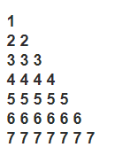
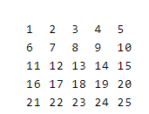
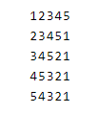
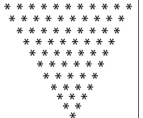
Write simple java program to print some patterns ( 6 patterns)
Input stream will be taught later. Time being hardcode the limit value

Slide 8
Learn more of Eclipse IDE from this link
https://www.tutorialspoint.com/eclipse/eclipse_explore_windows.htm

